Slide 1



Supper Scholars

Slide 2
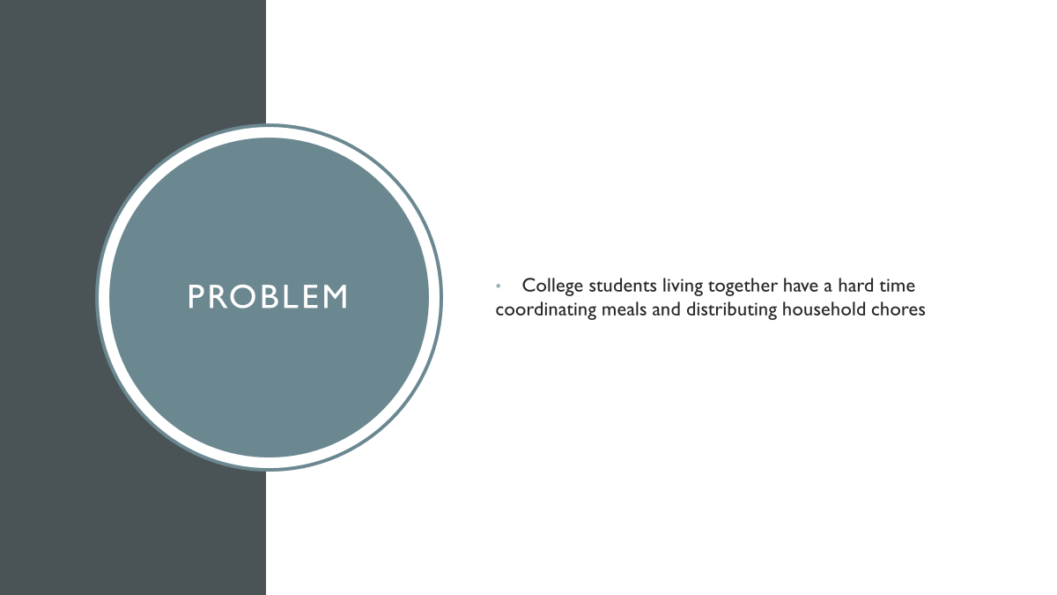
Problem
College students living together have a hard time coordinating meals and distributing household chores

Slide 3
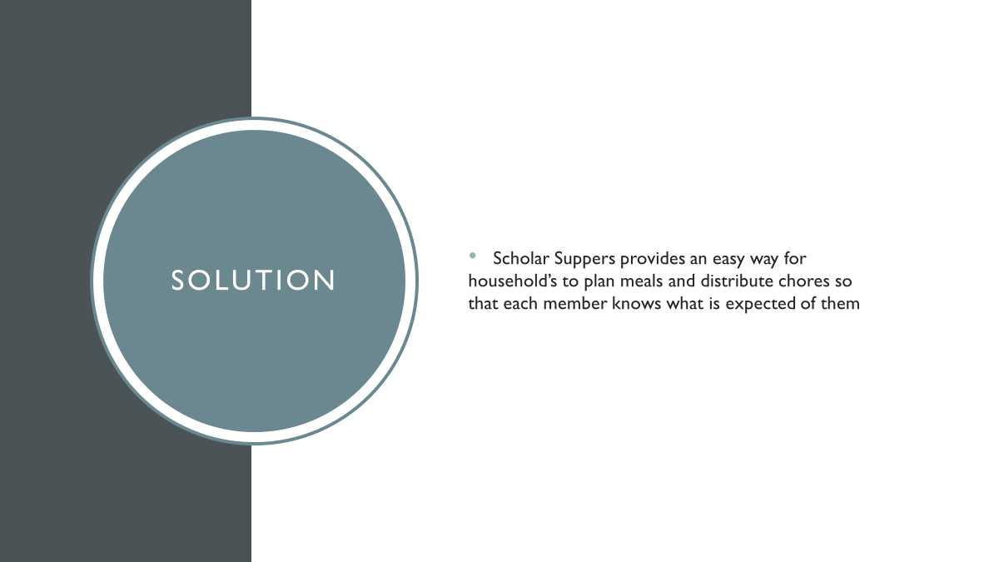
Solution
Scholar Suppers provides an easy way for household’s to plan meals and distribute chores so that each member knows what is expected of them

Slide 4
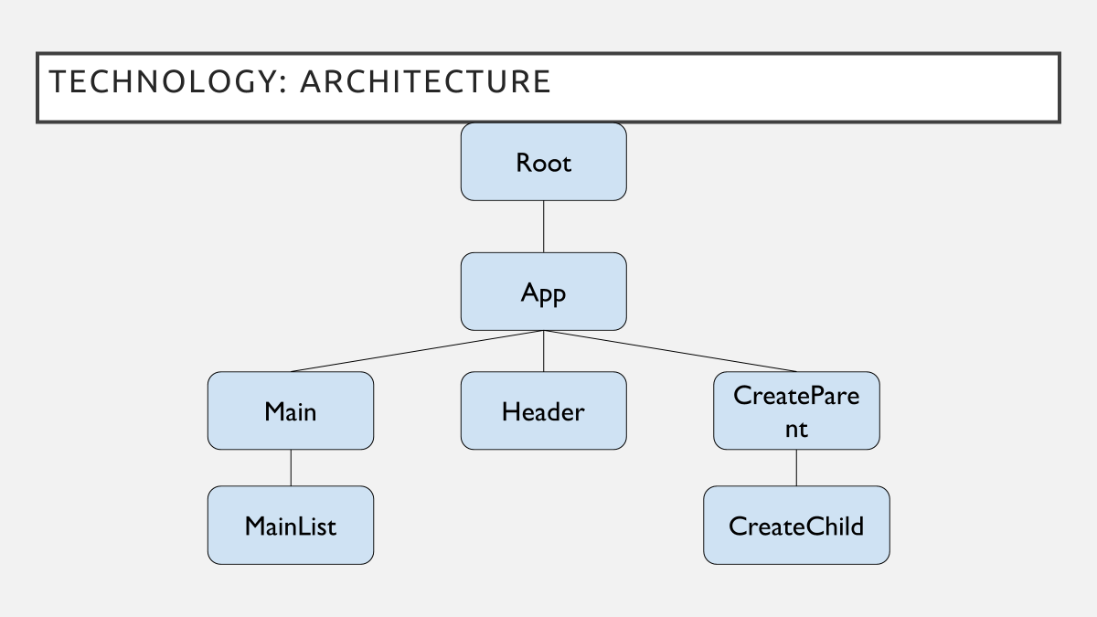
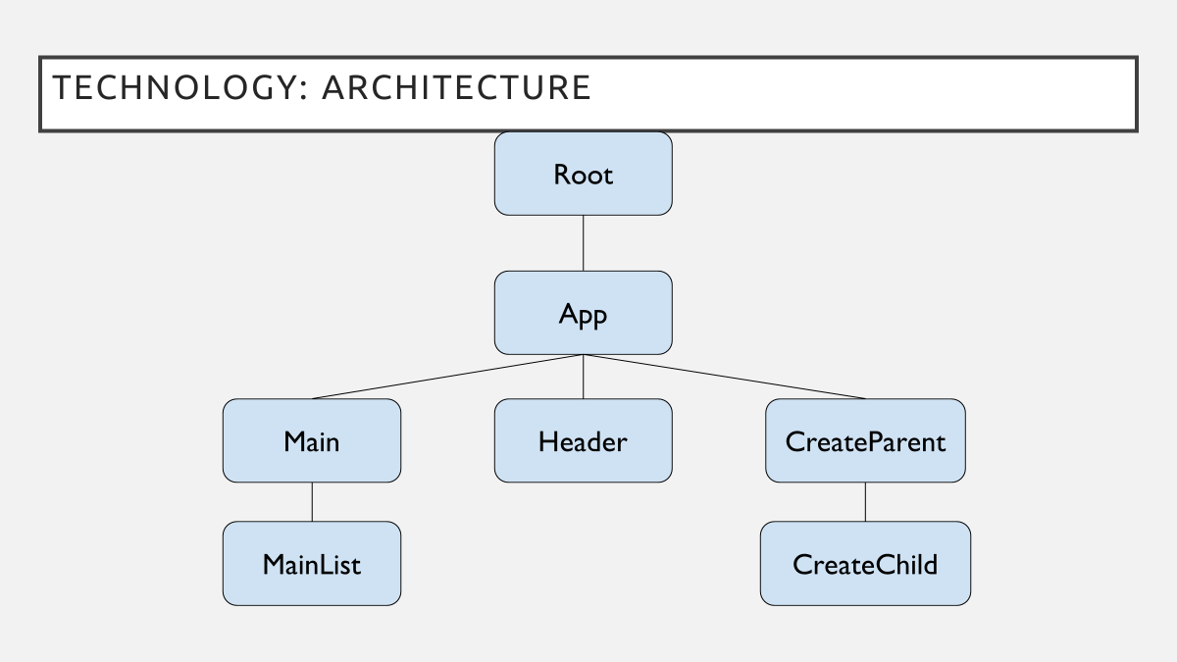

Slide 5
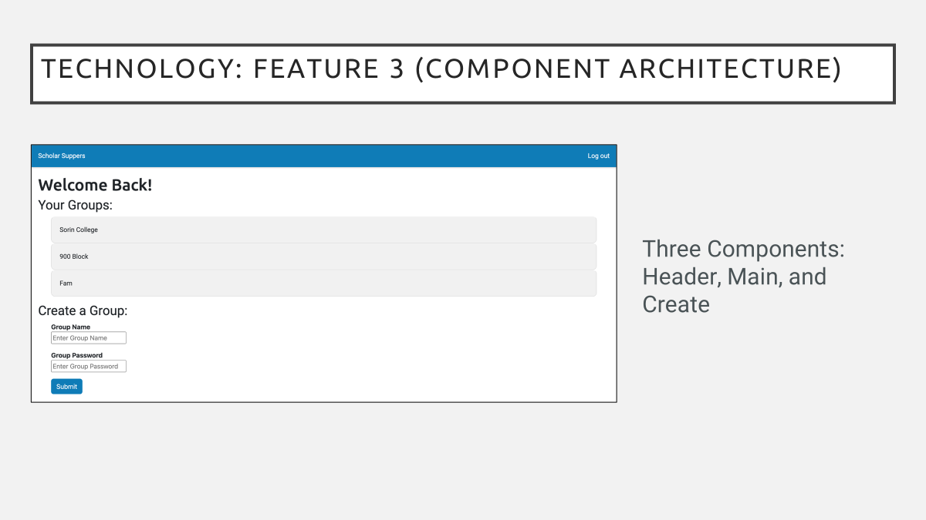
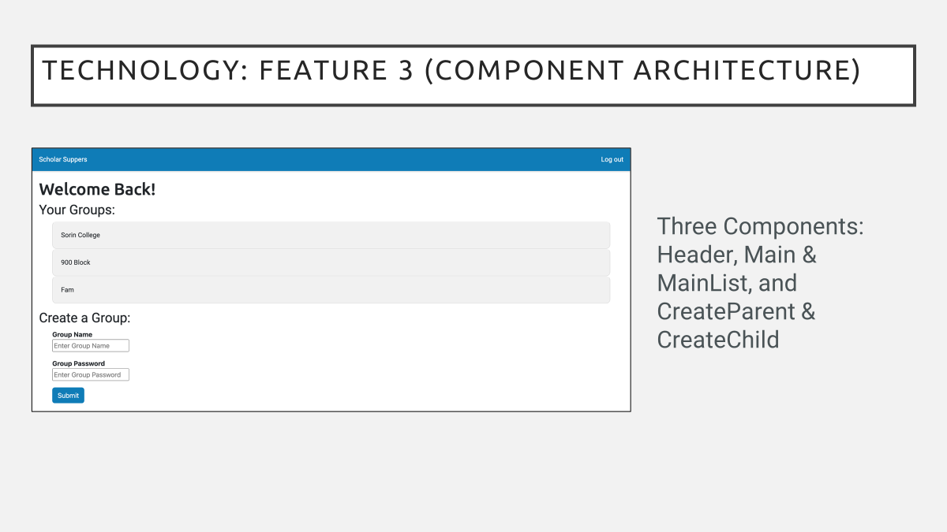
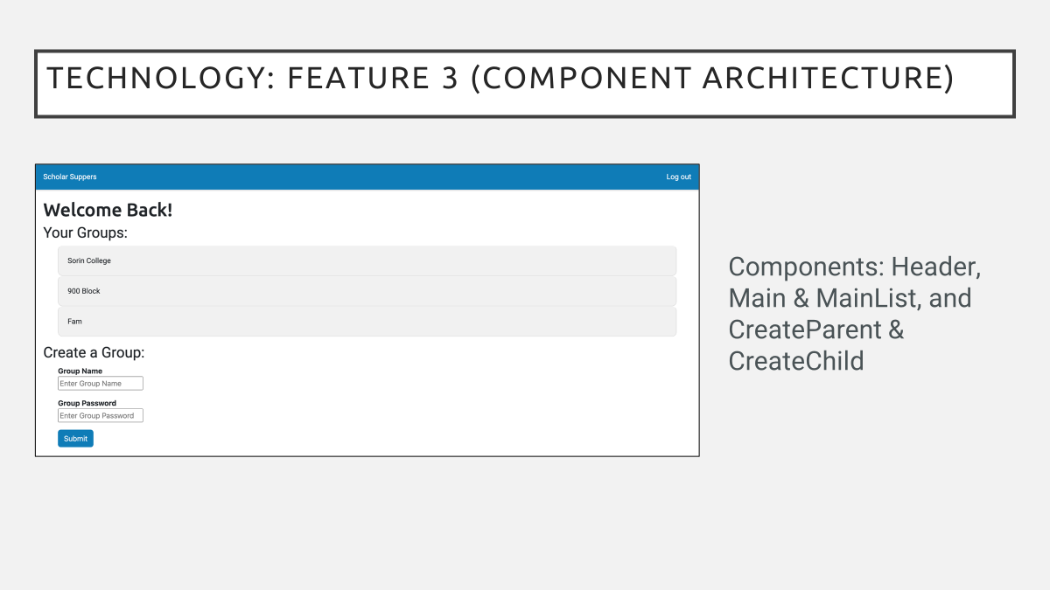
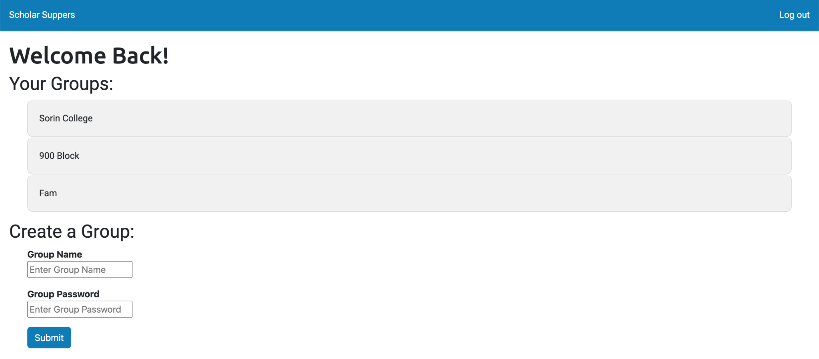
Technology: Feature 3 (Component Architecture)
Three Components: Header, Main, and Create

Slide 6
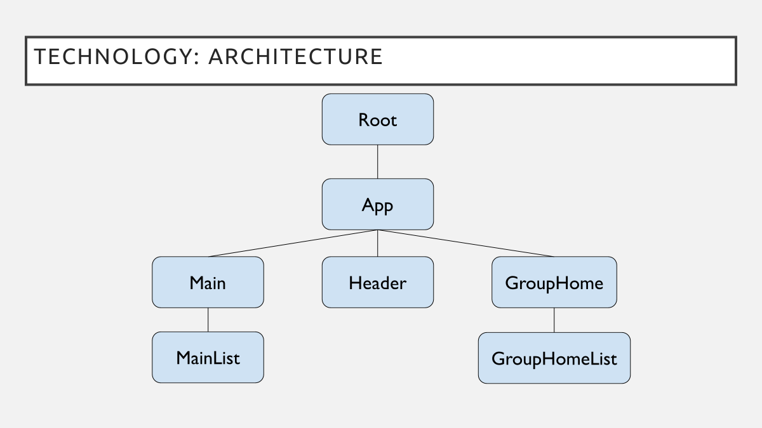
Technology: Architecture
Root
App
Main
Header
GroupHome
MainList
GroupHomeList

Slide 7

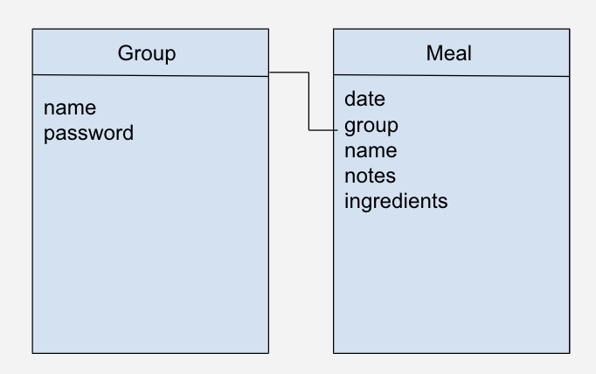
TECHNOLOGY: ARCHITECTURE

Slide 8
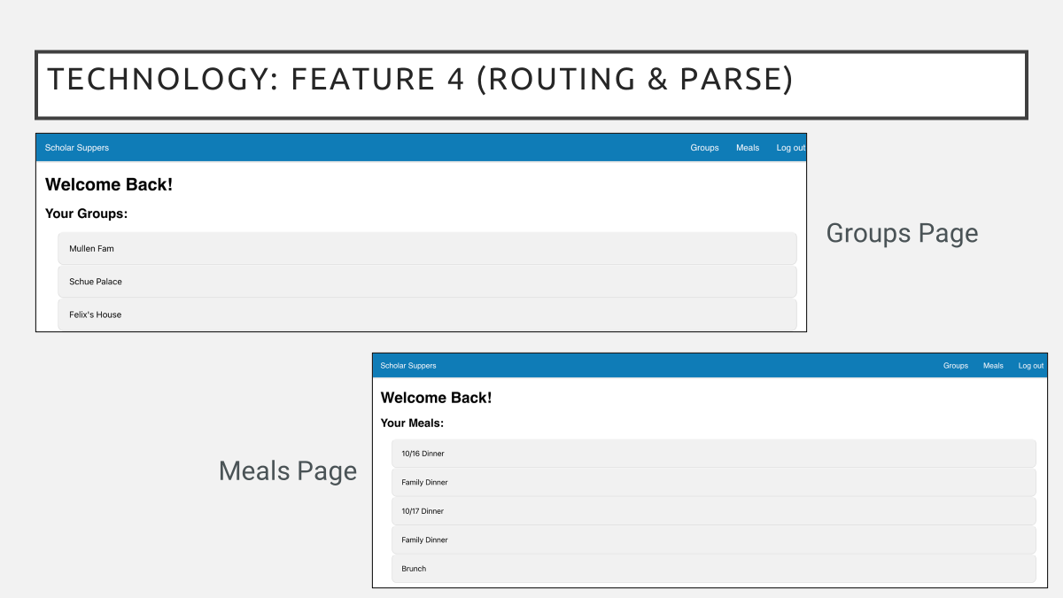
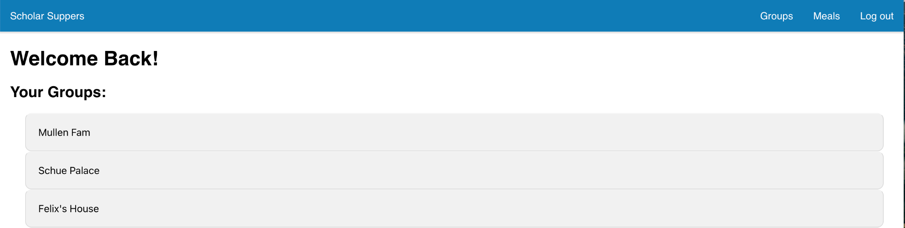
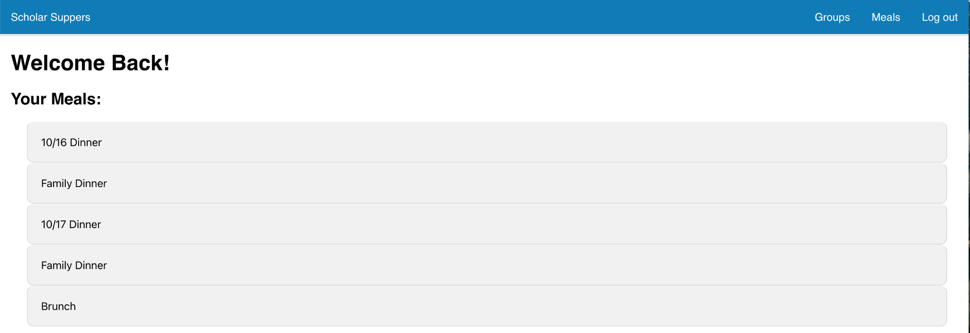
Technology: Feature 4 (Routing & Parse)
Groups Page
Meals Page

Slide 9
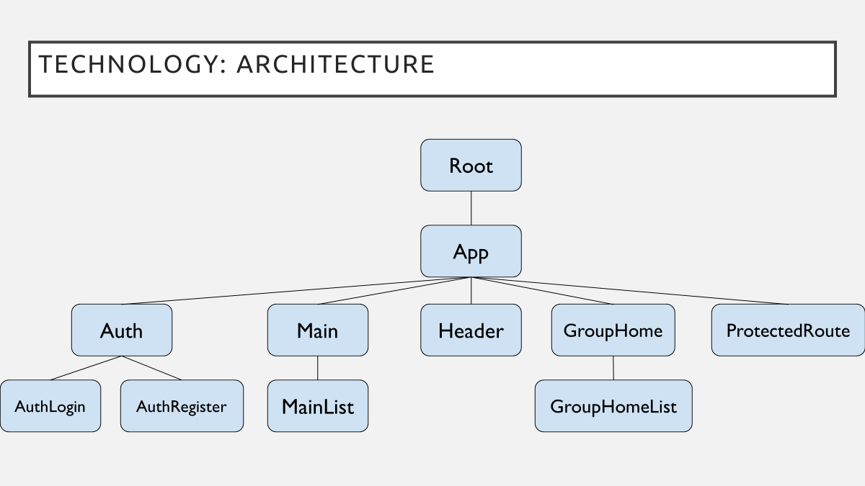
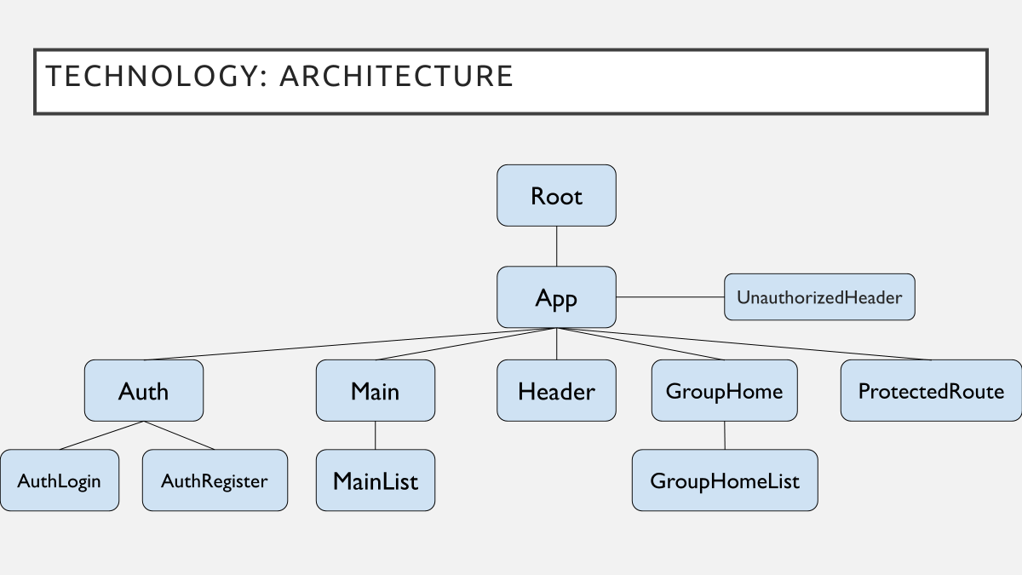
Technology: Architecture
Root
App
Auth
Main
Header
GroupHome
ProtectedRoute
AuthLogin
AuthRegister
MainList
GroupHomeList

Slide 10
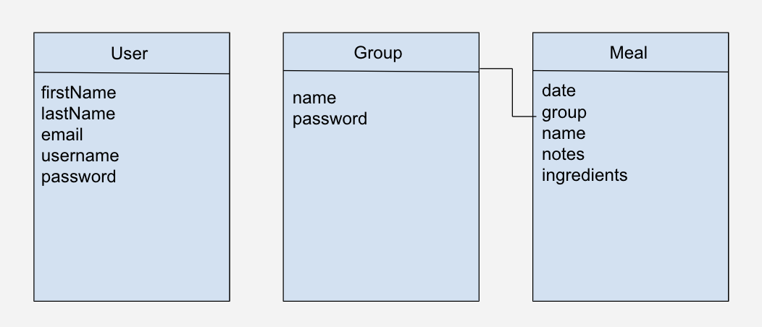
TECHNOLOGY: ARCHITECTURE

Slide 11
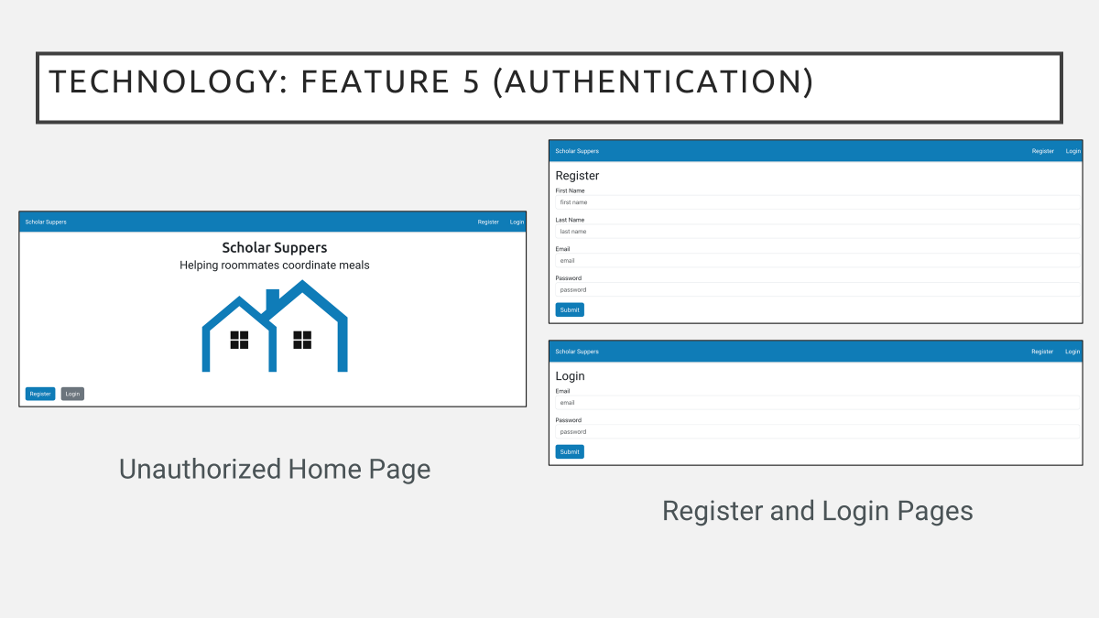
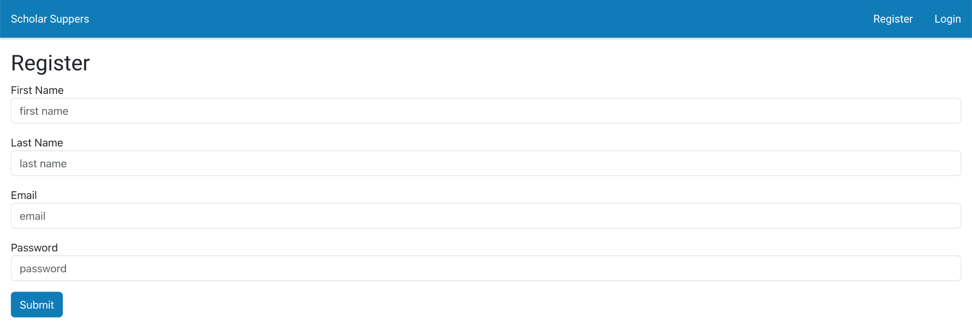
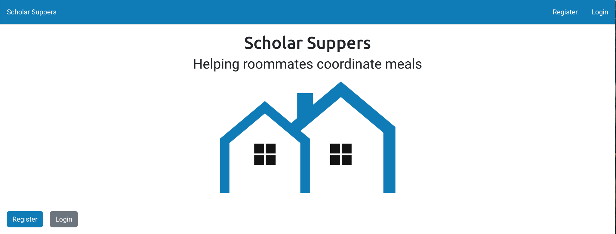
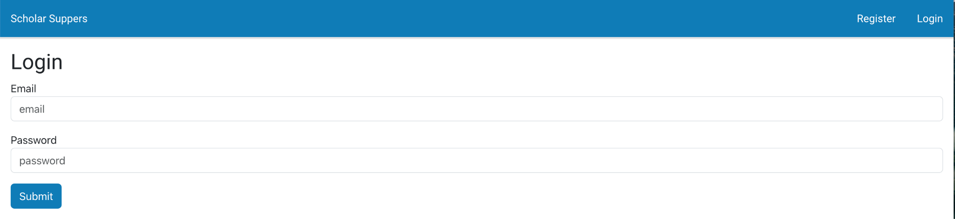
Technology: Feature 5 (Authentication)
Unauthorized Home Page
Register and Login Pages

Slide 12
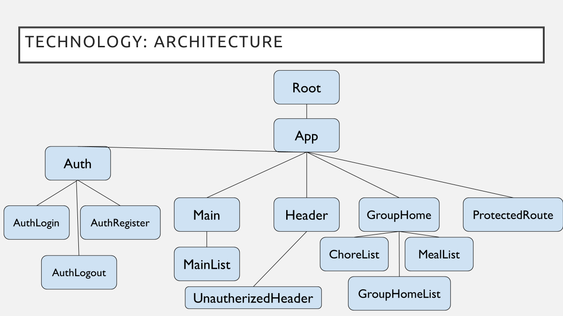
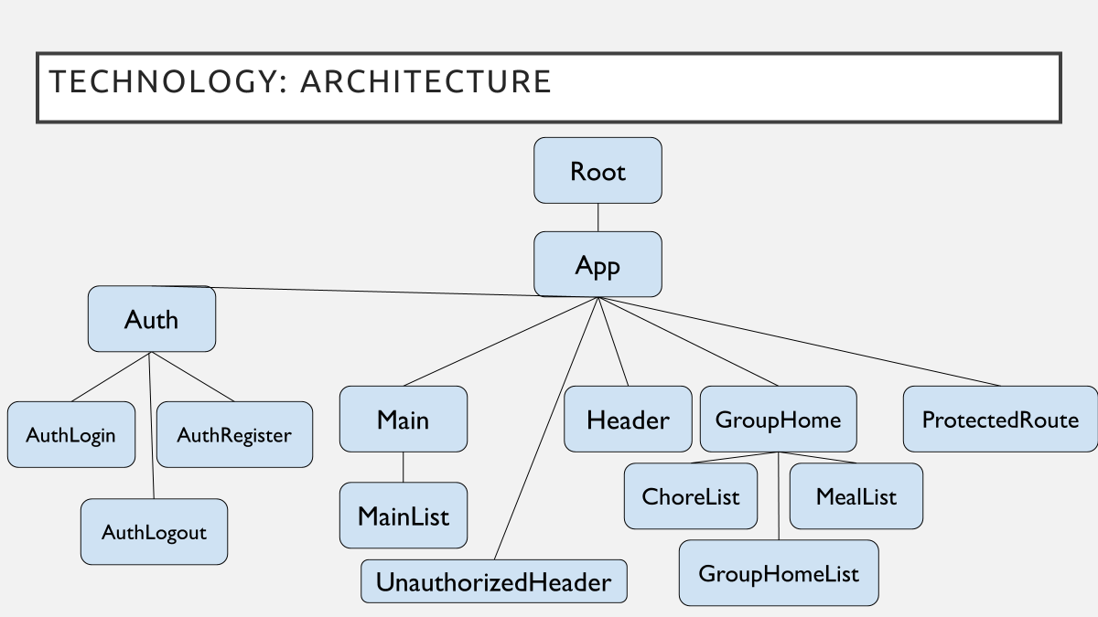
Technology: Architecture (F6)

Slide 13
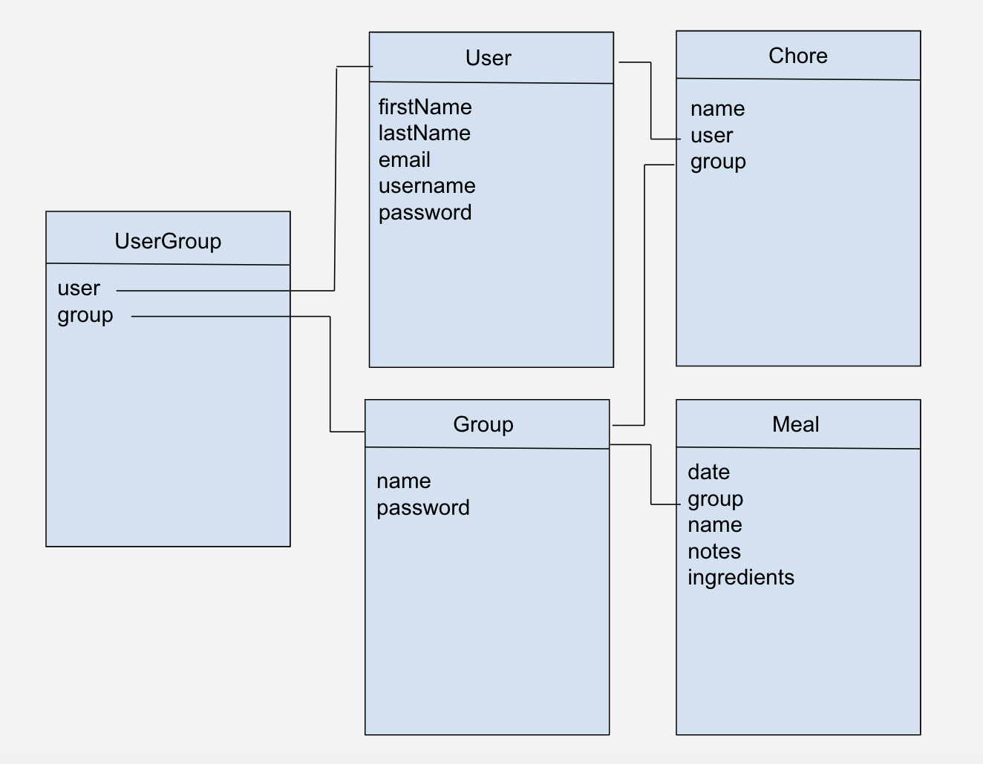
TECHNOLOGY: ARCHITECTURE

Slide 14
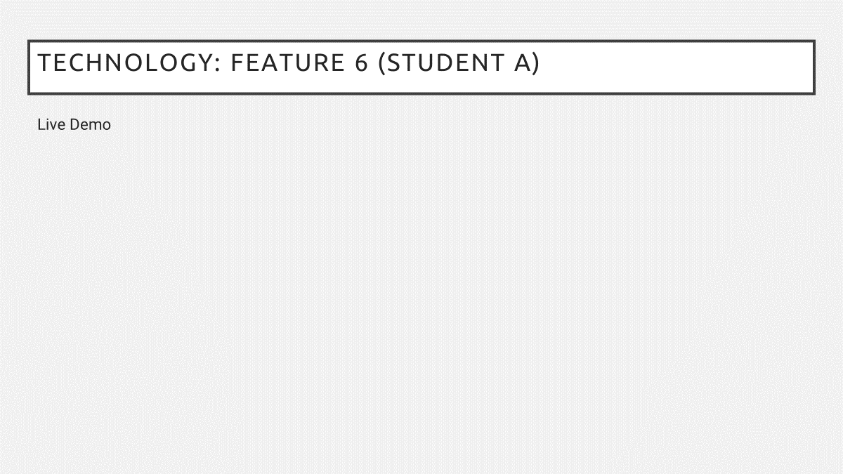
Technology: Feature 6 (Student A)
Live Demo

Slide 15
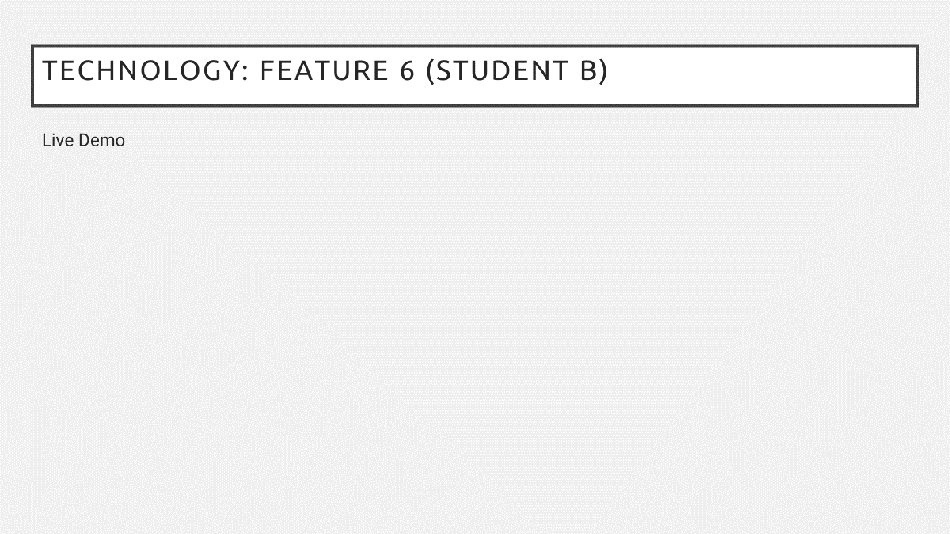
Technology: Feature 6 (Student B)
Live Demo

Slide 16
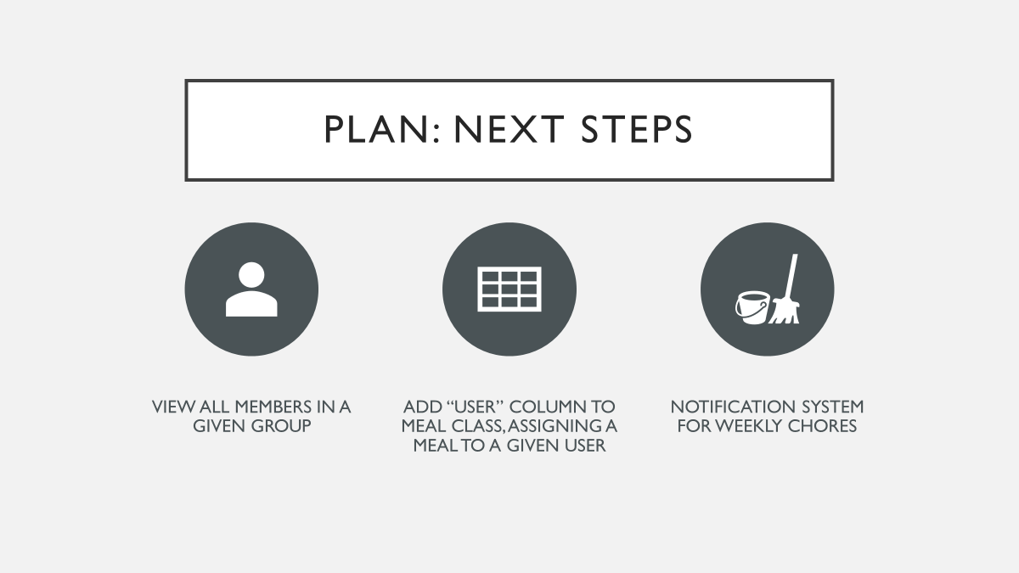
Plan: Next Steps
View all members in a given group
Add “user” column to Meal class, assigning a meal to a given user
Notification system for weekly chores

